Slide 1




SAI VIDYA INSTITUTE OF TECHNOLOGY
RAJANUKUNTE, BENGALURU - 560064
DEPARTMENT OF COMPUTER SCIENCE AND ENGINEERING
Mini Project Phase-2
Presentation On
“Flood detection in Metropoliton Cities”
Under the guidance of
Presented By
Mithun M S 1VA22CS073
Ramprasad 1VA22CS100
Sagar P 1VA22CS105
Harshith V 1VA22CS123
Dr. Tejashwini N
Associate Professor,
CSE, SVIT
Dr. Shantakumar B Patil
Associate Dean, R & D, CSE, SVIT

Slide 2

PRESENTATION OUTLINE
Recap(Phase-1 Presentation Summary)
Design
Methodology
Implementation
Expected Outcomes
Conclusion
References
Dept. of CSE, SVIT
Slide No: 1

Slide 3
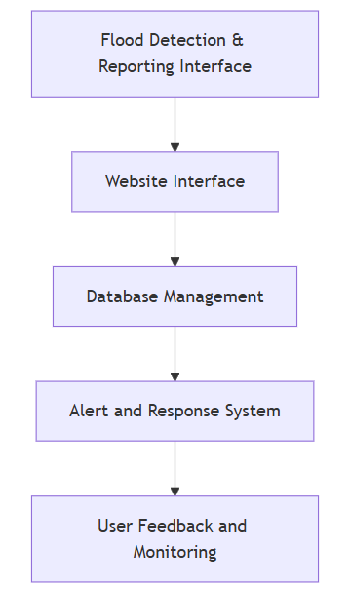
Recap(Phase-1 Presentation Summary)
The community-driven flood detection system allows Bangalore residents to upload geotagged photos of flooded areas to a website, which sends reports to authorities for real-time management. The system architecture includes interfaces for reporting, database management, alerts, and user feedback. It aims to improve data accuracy, enable predictive analysis, reduce economic loss, and inform urban planning. Hardware requirements include user devices, servers, and networking equipment, while software covers web development, databases, geolocation, and hosting services. The project fosters community engagement, faster response times, reduced disruptions, and better infrastructure planning to enhance urban flood resilience.
Dept. of CSE, SVIT
Slide No: 2

Slide 4
Design(Use case & DB-Schema Diagram)
Sense / Detect Flood
User Interface (UI): An intuitive interface for users to upload geotagged flood photos with essential details.
Automated Detection: CCTV cameras and flood sensors in flood-prone areas autonomously monitor and report water levels.
Backend Infrastructure: A secure, cloud-based backend for data processing, geolocation tracking, validation, and transmission to authorities.
Notification System: An alert system sends data to municipal officers, ensuring a 30-minute response time with fail-safes for prompt receipt and action.
CCTV Capture Photo
User Capture Photo
User can View the Updates
Website GUI
DataBase
Analyze critical Area
Alert BBMP / Traffic Police
Dept. of CSE, SVIT
Slide No: 3

Slide 5
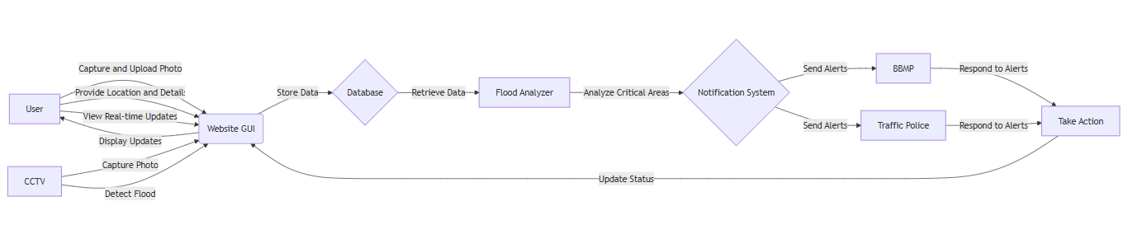
Design(Use case & DB-Schema Diagram)
Dept. of CSE, SVIT
Slide No: 4

Slide 6
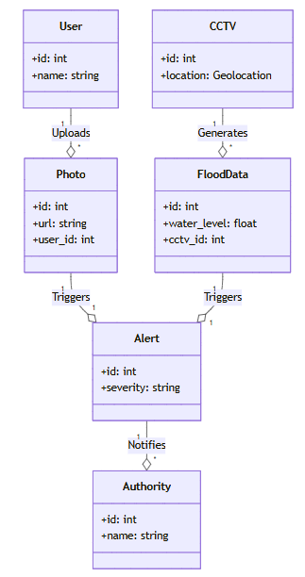
Design(Class Diagram)
Dept. of CSE, SVIT
Slide No: 5

Slide 7
Methodology
Resident Reports: Residents upload geotagged flood photos with personal details, creating a real-time citywide flood map.
Automated Detection: Sensors and CCTV in flood-prone zones automatically flag high water levels, alerting authorities.
Data Validation: Geotags and sensor data cross-verify reports, enhancing accuracy and reducing false alerts.
Real-time Notifications: Instant alerts to local authorities ensure a 30-minute response time for critical issues.
Authority Communication: Validated data is sent to authorities via a dashboard for prioritized response.
Dept. of CSE, SVIT
Slide No: 6

Slide 8
Implementation
Website and Reporting Interface :
Prototype website for users to upload geotagged photos and details.
Demonstrates UI, data entry, and submission workflow.
Basic Backend Development :
Initial setup for secure data handling of geotagged reports.
Cloud database for storing user submissions and sensor data.
Dept. of CSE, SVIT
Slide No: 7

Slide 9
Implementation
Automated Alerts from CCTV and Sensors
Prototype of flood-detecting sensors and CCTV alerts.
Simulated flood conditions to demonstrate detection and alert system.
Dashboard for Authorities
Prototype dashboard for viewing and prioritizing incoming reports.
Interface for authorities to validate and manage responses.
Dept. of CSE, SVIT
Slide No: 8

Slide 10
Expected Outcomes:
Faster Response Times: Authorities can address flooding within 30 minutes, enhancing public safety.
Enhanced Community Engagement: Increased resident reporting fosters responsibility and strengthens community ties.
Improved Data Accuracy: Geotagged photos provide reliable, real-time information for effective decision-making.
Reduced Flood Disruptions: Timely interventions maintain road accessibility and minimize daily life impact.
Better Infrastructure Planning: Data informs long-term strategies, allowing effective resource allocation for flood prevention.
Dept. of CSE, SVIT
Slide No: 9

Slide 11
Conclusion:
Community Participation: Residents upload geotagged photos of floods, fostering active involvement in flood management.
Timely Response: Municipal authorities can respond to flooding reports within 30 minutes, enhancing public safety.
Enhanced Urban Resilience: The initiative improves data accuracy and supports better planning for future flooding events.
Dept. of CSE, SVIT
Slide No: 10

Slide 12
References:
Alaoui, A., et al. (2023). "IoT for flood management: A review." Journal of Environmental Management, 257, 109973. DOI: 10.1016/j.jenvman.2023.109973.
Mastrorillo, M., et al. (2022). "Community engagement in flood management: A review." Water, 8(6), 258. DOI: 10.3390/w8060258.
Rogers, L., et al. (2021). "Geotagging for Flood Management: Enhancing Community Resilience." Natural Hazards, 94, 257-276. DOI: 10.1007/s11069-018-3177-8.
Ministry of Earth Sciences, India. (2021). "Guidelines for Urban Flood Management." moes.gov.in
Bangalore Development Authority (BDA). (2022). "Bangalore Urban Flooding Management: A Strategic Framework." bda.gov.in.
Dept. of CSE, SVIT
Slide No: 11

Slide 13
References:
Jha et al. (2012). "Cities and Flooding: A Guide to Integrated Urban Flood Risk Management. " Covers risk assessment, structural and non-structural measures and community participation.
Tingsanchali (2012). "Urban flood disaster management." Discusses integrated approaches, early warning systems, and community involvement.
Gupta & Nair (2010). "Urban floods in Bangalore and Chennai." Examines flood risks and need for sustainable urban ecology and management strategies..
NDMA, India (2019). "National Guidelines: Management of Urban Flooding." Provides a framework covering risk assessment, warning systems, response, and capacity building.
Ramachandran et al. (2017). "Flood hazard and risk assessment using geospatial techniques." Demonstrates application of geospatial techniques for flood management in India.
Dept. of CSE, SVIT
Slide No: 12

Slide 14

Thank You
Dept. of CSE, SVIT
Slide No: 9

